Slide 1


Project Presentation:
AI Study Buddy
~ AI Powered Study Planner

Slide 2

PRESENTATION OF LEARNING PROJECT
Study Buddy – AI Powered Study Planner
Presented by : S. Karthika
M. Nadhisha
V. Priyadharshini
S. Subhashini
Department: B. Tech Artificial Intelligence and Data Science.
College: SKP Engineering College.
Our project aims to simplify study planning through an AI-powered assistant that adapts to each student’s needs.

Slide 3
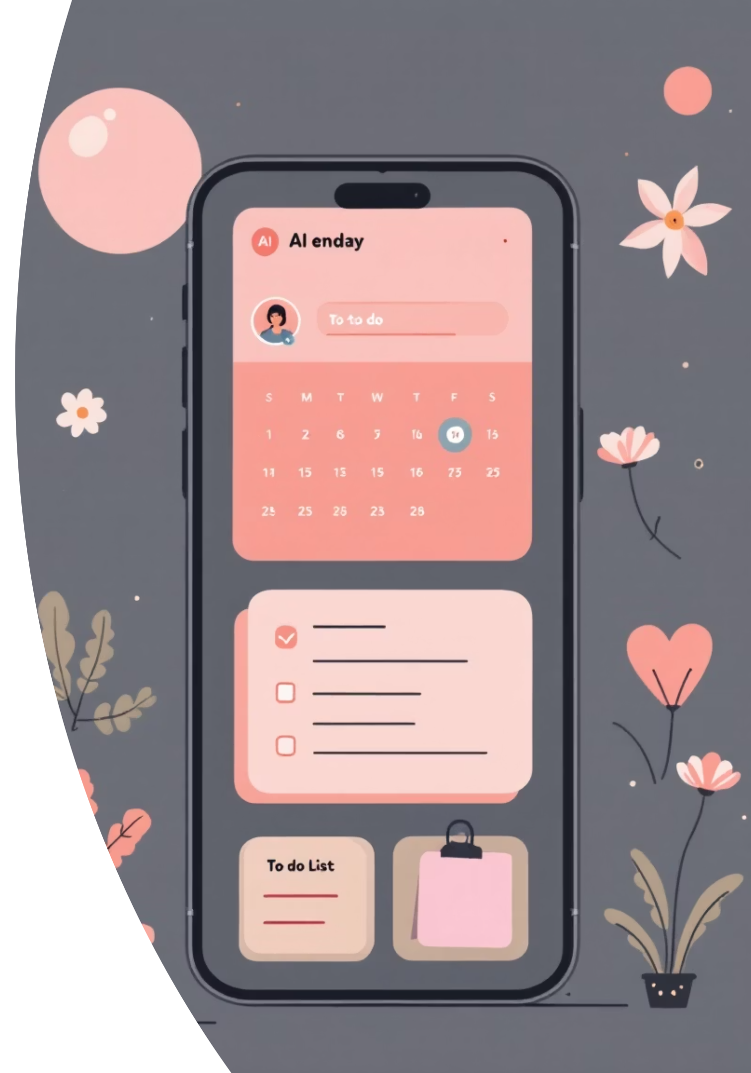
Introducing Study Buddy : The Smart Study Assistant
The Challenge
The Deficiency
Students often struggle with managing complex study schedules and maintaining consistency over time.
Manual planners are time-consuming, difficult to update, and lack the flexibility needed to adapt to real-life changes.
The Solution: Doodle Study
A smart AI-based web application that automatically organizes subjects, sets dynamic reminders, and tracks progress with minimal manual input.
“This project is designed to give every student a personal, intelligent study coach that simplifies and optimizes their learning journey.”

Slide 4

Project Scope and Core Objectives
The main scope of this project is to make studying more organized and consistent through automation, targeting maximum accessibility and personalization.
🎯 Scope
Designed for a wide user base: students, self-learners, and professionals preparing for competitive exams.
Cross-platform compatibility: Seamless functionality on both desktop and mobile devices.
💡 Objectives
1
Schedule Automation
Automate the creation of optimal study schedules based on user input and learning goals.
2
Personalized Reminders
Provide timely and flexible reminders to ensure adherence to the study plan.
3
Performance Tracking
Accurately track study progress and analyze performance metrics.
4
Motivation and Support
Motivate students continually through encouraging and friendly AI feedback and support.

Slide 5






Design Thinking Approach
we followed the design thinking process meticulously to ensure the application is practical, highly intuitive, and deeply user-friendly.
Empathize
Define
Ideate
Prototype
Test
Empathize
Deeply understood student struggles regarding time management and consistency.
Define
Clearly identified the need for a smart, flexible scheduling and automated reminder system.
Ideate
Brainstormed various concepts for AI automation, simple UI/UX, and motivational features.
Prototype
Built the Minimum Viable Product (MVP) using React, Tailwind CSS, and
integrated AI components.
Test
Conducted rigorous testing with student groups, collecting feedback and
iteratively improving the design.

Slide 6


Insights from User Research
The research confirmed that students are actively seeking a digital planner that genuinely adjusts to their dynamic lifestyle and academic pressures.
Key Challenges Reported by College Students
Consistency is Difficult: Maintaining a steady study rhythm over long periods is the biggest hurdle.
High Distraction Levels: External factors constantly interrupt focus and dedicated study blocks.
Need for Automation: Strong demand for automatic, flexible schedules that remove manual planning effort.
Reliable Reminders: Desire for automated, timely nudges to ensure they return to their learning tasks.

Slide 7





On topic difficulty and available time slots.
Time Slot Recommendation
The AI intelligently recommends the most suitable time blocks for dedicated study across different subjects.
Monitoring & Tracking
The application actively sends reminders and records real-time progress against the set learning milestones.
Motivational Feedback
Users receive positive and constructive feedback immediately after completing a study session to maintain momentum.

Slide 8



User Testimonials & Personal Experiences
Sarah Chen
Omar Hassan
Priya Sharma
Undergraduate, Computer Science
Postgraduate, Mechanical Engineering
High School Student, IB Program
"The AI Study Buddy has been a game-changer for my Computer Science degree. The time slot recommendations perfectly fit my busy schedule, and the progress tracking keeps me motivated. I've seen a significant improvement in my retention of complex algorithms, all thanks to its adaptive learning approach!"
"As a postgraduate student, managing research and coursework is tough. This app's automatic planning feature is brilliant; it breaks down my study topics based on difficulty and allocates time efficiently. The motivational feedback after each session is a great boost too!"
"Studying for the IB program requires intense focus across many subjects. The AI Study Buddy helps me organize my study blocks and gives me clear insights into my strengths and weaknesses. My grades have improved, and I feel much more confident heading into exams!"

Slide 9










Information Architecture (IA)
The app’s structure is clean and intuitively logical—each section focuses on removing friction and helping the student achieve learning consistency.
Add Subject
Dashboard
Input module for users to enter subject details, topics, and initial assessment of difficulty.
Provides a high-level overview of all subjects, upcoming deadlines, and current progress metrics.
Schedule
Displays the dynamically generated, AI-optimized daily and weekly study timetable.
Reports
Detailed analytics of study time, subject coverage, and logs of any missed or rescheduled sessions.
Reminders
Customizable settings for push notifications and email alerts to ensure timely study commencement.
This five-pillar structure ensures the user has a central hub for planning and a clear path for tracking their educational development.

Slide 10
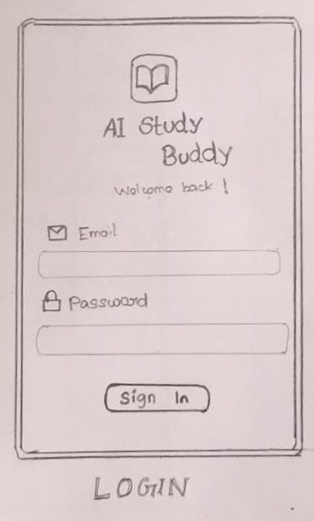
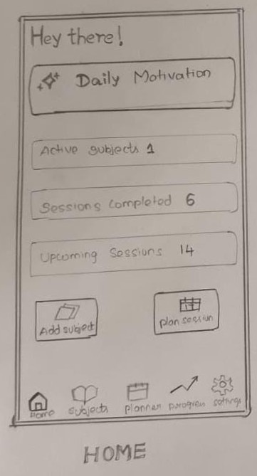
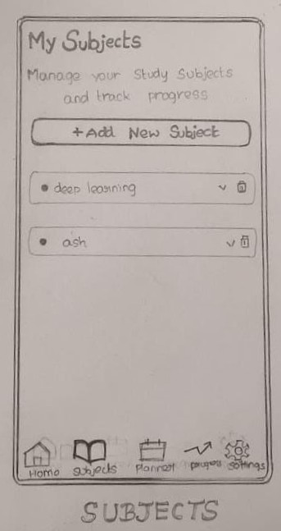

Slide 11
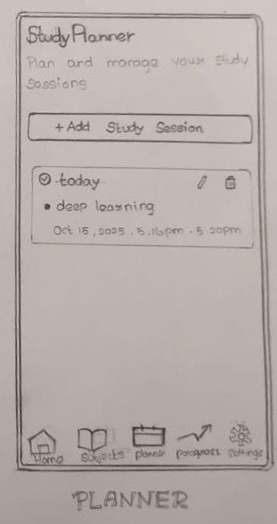
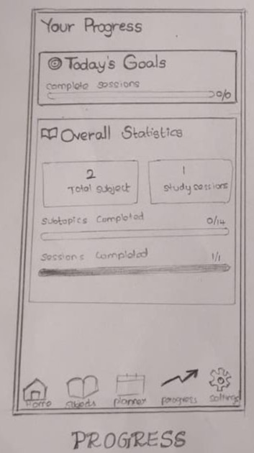
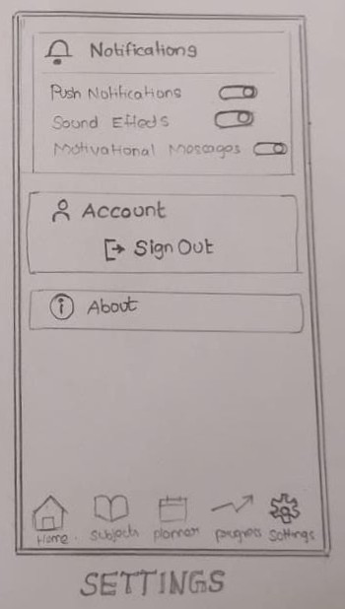

Slide 12
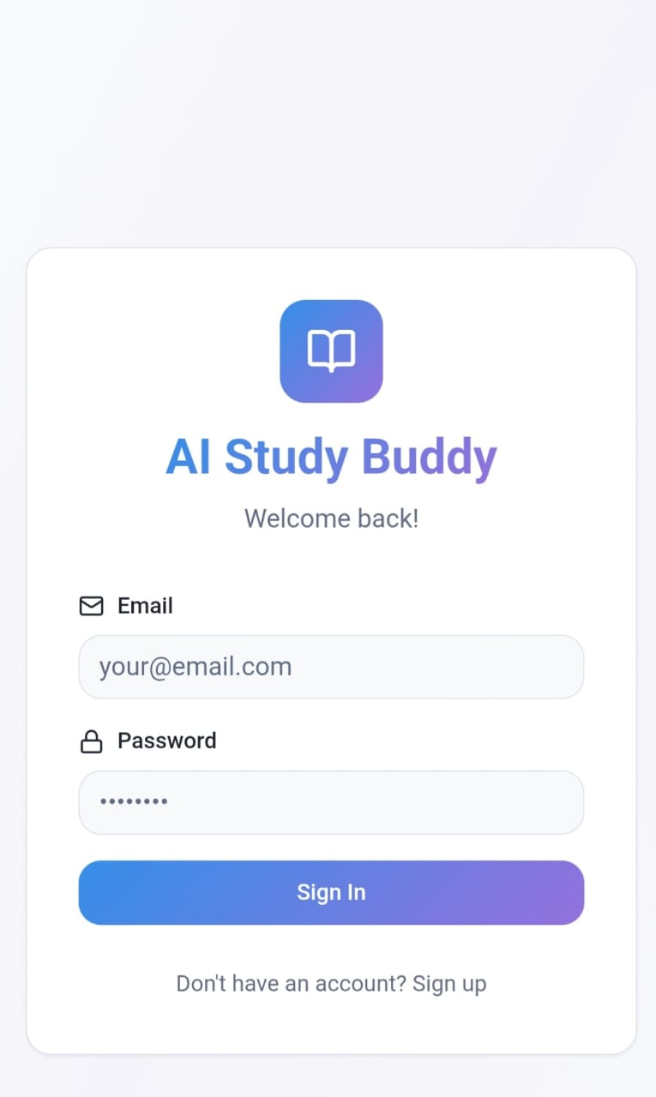
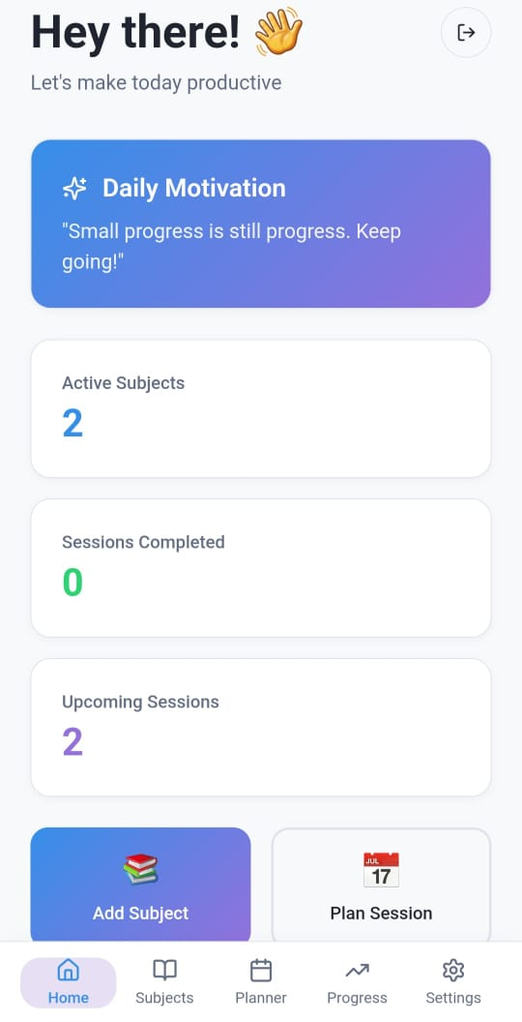
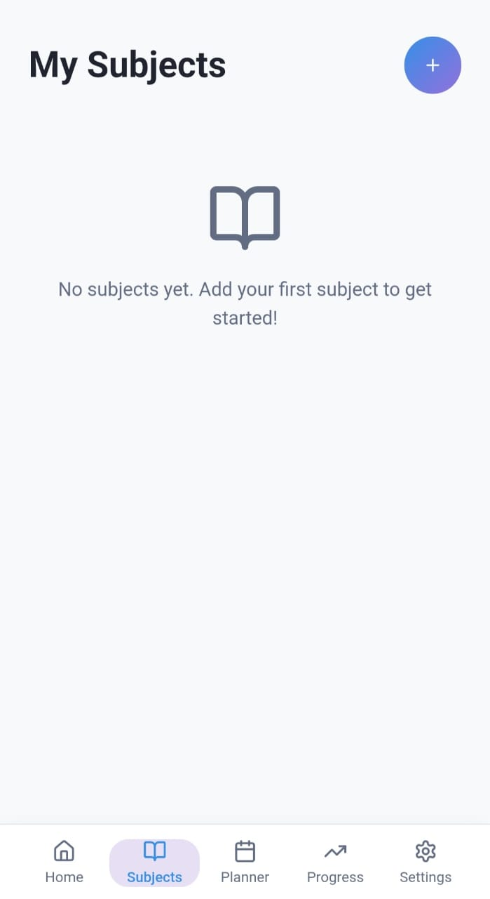

Slide 13
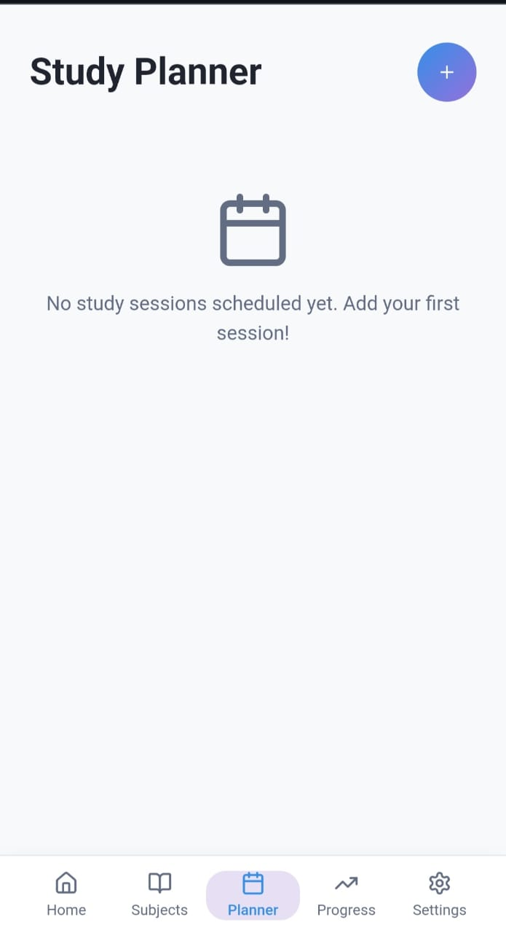
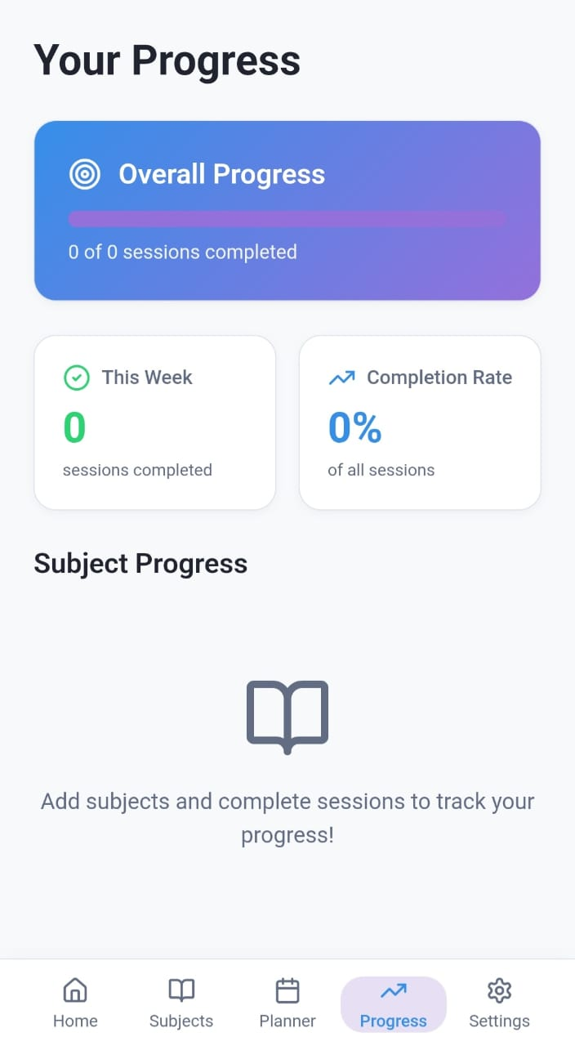
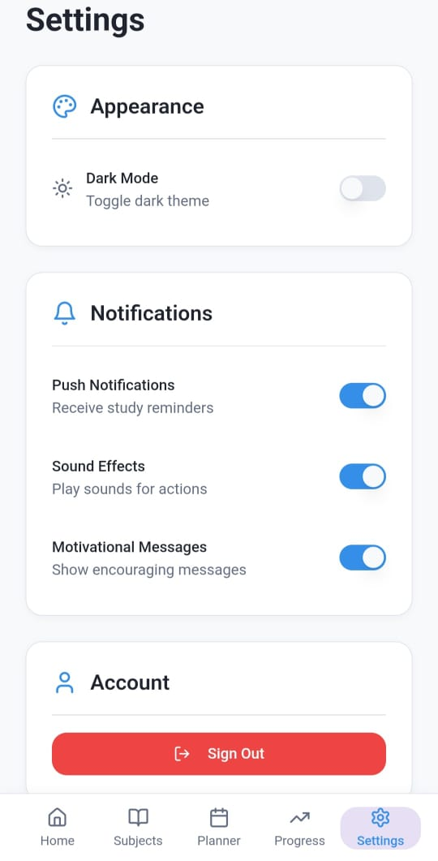

Slide 14
Conclusion :
AI Study Buddy is a smart, AI-powered study planner designed to simplify and personalize learning.It helps students automate schedules, set reminders, and track progress efficiently. By applying the Design Thinking process, we identified real student challenges and created a user-friendly, intelligent solution. The project shows how AI can improve consistency, motivation, and productivity in daily learning.In the future, we aim to integrate machine learning, mobile app support, and calendar synchronization for better usability.Our vision: “To help every student study smarter, not harder.”

